Slide 1
MICRO – CREDIT DEFAULTER PROJECT
Presented By: Akshay Dinesh Shah

Slide 2
Problem Statement And Understanding
Problem Statement:
A Microfinance Institution (MFI) is an organization that offers financial services to low income populations. MFS becomes very useful when targeting especially the unbanked poor families living in remote areas with not much sources of income. The Microfinance services (MFS) provided by MFI are Group Loans, Agricultural Loans, Individual Business Loans and so on.
Many microfinance institutions (MFI), experts and donors are supporting the idea of using mobile financial services (MFS) which they feel are more convenient and efficient, and cost saving, than the traditional high-touch model used since long for the purpose of delivering microfinance services. Though, the MFI industry is primarily focusing on low income families and are very useful in such areas, the implementation of MFS has been uneven with both significant challenges and successes.
Today, microfinance is widely accepted as a poverty-reduction tool, representing $70 billion in outstanding loans and a global outreach of 200 million clients.
We are working with one such client that is in Telecom Industry. They are a fixed wireless telecommunications network provider. They have launched various products and have developed its business and organization based on the budget operator model, offering better products at Lower Prices to all value conscious customers through a strategy of disruptive innovation that focuses on the subscriber.

Slide 3
They understand the importance of communication and how it affects a person’s life, thus, focusing on providing their services and products to low income families and poor customers that can help them in the need of hour.
They are collaborating with an MFI to provide micro-credit on mobile balances to be paid back in 5 days. The Consumer is believed to be defaulter if he deviates from the path of paying back the loaned amount within the time duration of 5 days. For the loan amount of 5 (in Indonesian Rupiah), payback amount should be 6 (in Indonesian Rupiah), while, for the loan amount of 10 (in Indonesian Rupiah), the payback amount should be 12 (in Indonesian Rupiah).
The sample data is provided to us from our client database. It is hereby given to you for this exercise. In order to improve the selection of customers for the credit, the client wants some predictions that could help them in further investment and improvement in selection of customers.

Slide 4
Understanding of problem statement
A Micro Finance Institute (MFI) is an financial organization who focus and target the unbaked low income population, living in remote areas who does not have much source of income. They have global outreach of 200 million clients with $70 billion as an outstanding loans that is why these micro finance institutes are widely accepted as poverty reduction tools.
These MFIs have understood the importance of communication in a person’s daily life & how it affects the life of person hence to improve the basic need of communication of financially poor low income families living in remote areas they come up with a concept of providing mobile balance credits to the people, collaborating with a Telecom industry who provides wireless telecommunication network & are good with providing better offer at low price.
Now there is a challenge of default case where a user don’t pay back the loaned mobile balance back. To encounter this problem organization wants a machine learning model that can predict the default case so that they can prevent their financial loss & can improve their services.

Slide 5
Data Guide
In this project, a dataset was provided containing the details of the consumers who availed the loan .
The Dataset was first checked for null values, and then the various feature columns were analyzed. Exploratory Data analysis was conducted to investigate the relationships that existed between the columns, using various visualization techniques.

Slide 6
Content of Dataset
given dataset consists of :
37 columns
209593 rows
Target Column :- ‘Label’
In this case, Label ‘1’ indicates that the loan has been payed i.e. Non- defaulter, while, Label ‘0’ indicates that the loan has not been payed i.e. defaulter.

Slide 7
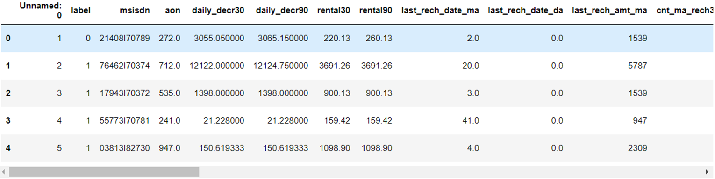
DATA PREPRATION
With the help of Pandas Library We will upload our data to Jupyter Notebook.
Once our data is uploaded with the help of predefined method (i.e. read_csv) we can read data for further processing.
We have two type of variables in the data:-
Dependent Variable
Independent Variable

Slide 8
Exploratory Data Analysis
For the exploratory data analysis and visualization of the data we used matplotlib library’s pyplot package & seaborn library.
For the understanding of categorical data we used count plot.
For the continuous data we used distribution plot.
We used box plot to see & understand the outliers in the data set.
For the correlation of the data we used heat map of seaborn.
We also used scikit’s roc plot to visualize the area under the curve to evaluate the machine learning models.

Slide 9
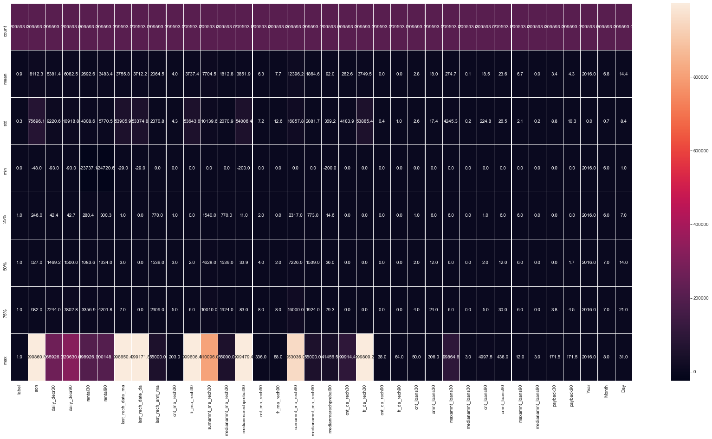
Statistical Summary of Dataset

Slide 10
Statistical summary
From the heat map we found that relation of all the features column with target column are not much high, maximum it is going upto 0.2. But we can see some of light color highlighted square in the heatmap which is showing relations of feature column with another feature column, & light color is showing some high relations between them, which is greater than 0.4 is most of the cases. So here we can interpret that some of pairs of columns are highly related with each other.

Slide 11
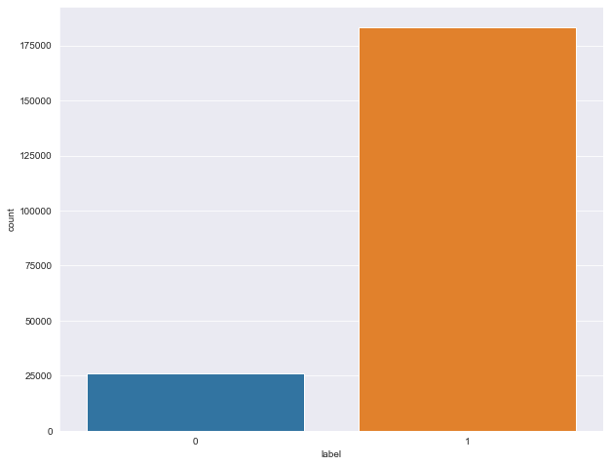
Analyzing the Target variable
Default and not default cases.
Where 0 was for default case & 1 was for not default case.
From the data visualization we analyzed that class data is imbalanced data.
Hence we concluded to balance the data by over sampling of class data.
Total records = 209593
Defaulter = 26162
Non_Defaulter = 183431
This picture tells us 12.5% people are Defaulter where as 87.5% people are not defaulter.

Slide 12
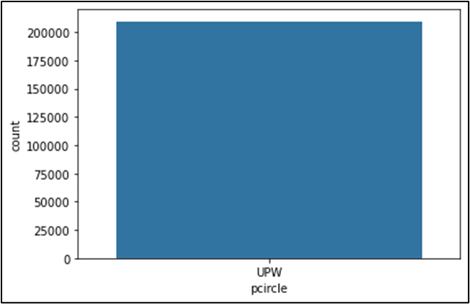
‘pcircle’ column had only 1 unique value UPW . Because it has only 1 unique value thus it's relation with all other feature column and target column would be same, hence we dropped the column from data set.

Slide 13
Data Visualization

Slide 14
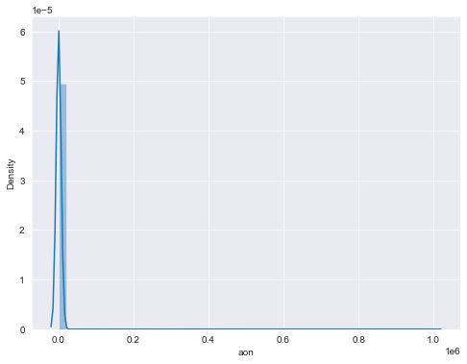
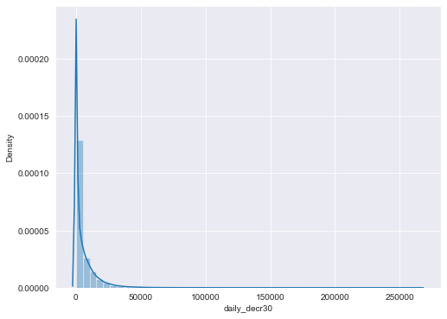
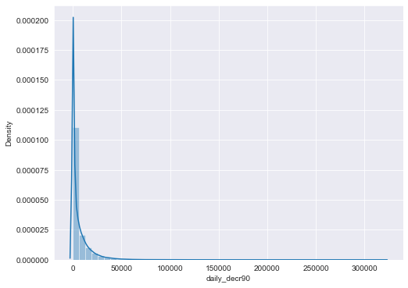
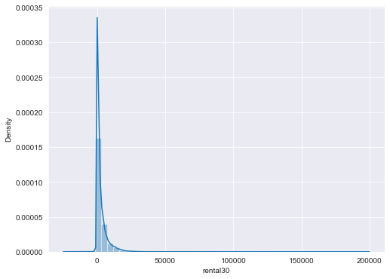
Data Distribution

Slide 15
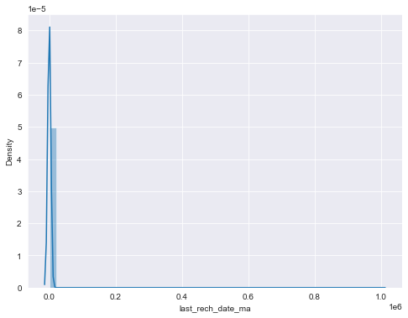
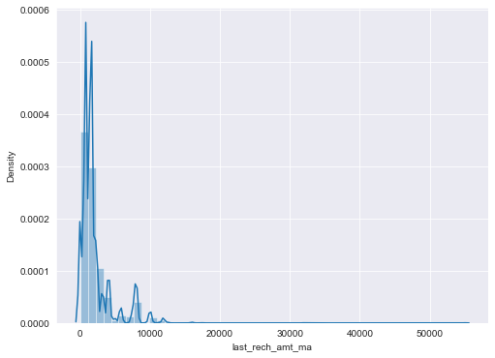


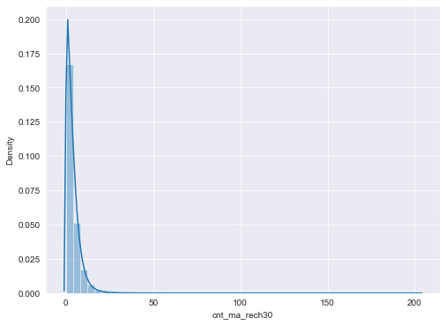
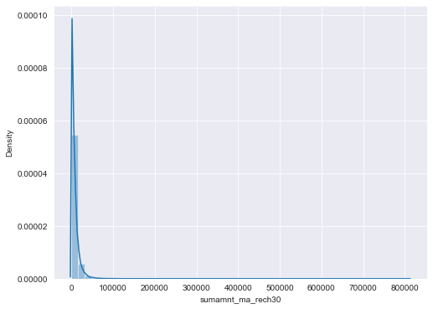

Slide 16
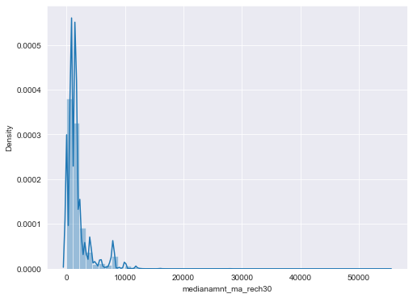
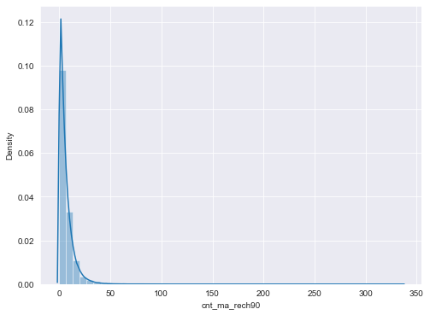
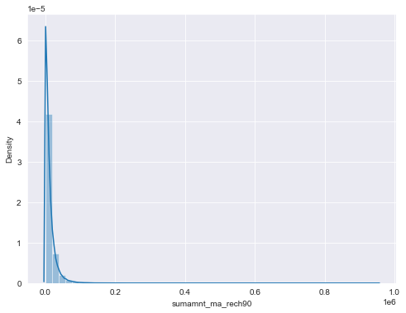

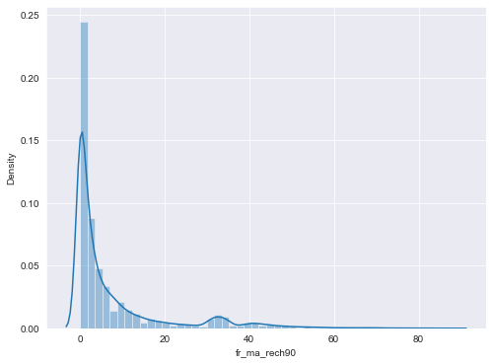


Slide 17
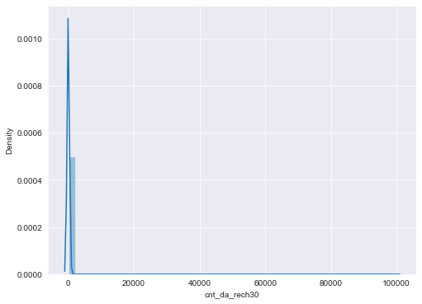
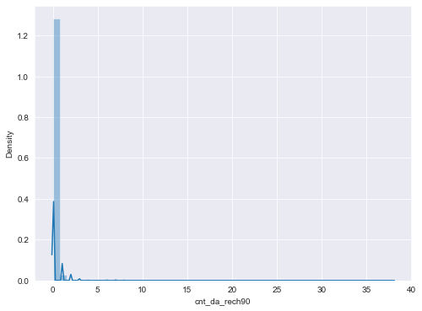
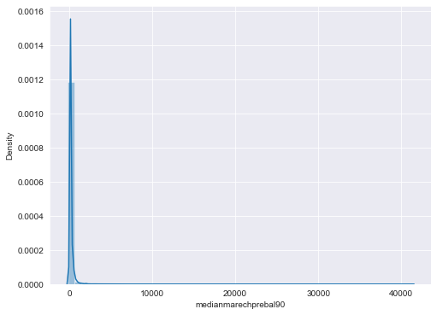

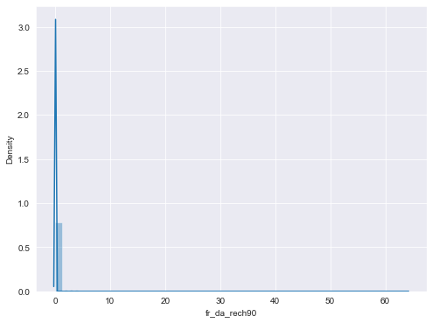

Slide 18
From the above graph, we can see that the distribution of the data in columns are quite complicated. Almost all the columns are heavily right skewed, we found that is because in almost all the column upto 75% & even 100% of the data are distributed in a certain range but there are some data points available in the column which are exceptionally far-far higher in positive side than the 100% of the data. which is making it heavily right skewed data distribution and this is the only reason why in almost all the columns mean value is smaller than the standard deviation. There are some of the columns also which are even left skewed along with right skewness like rental30, rental90, maxamnt_loans90.

Slide 19
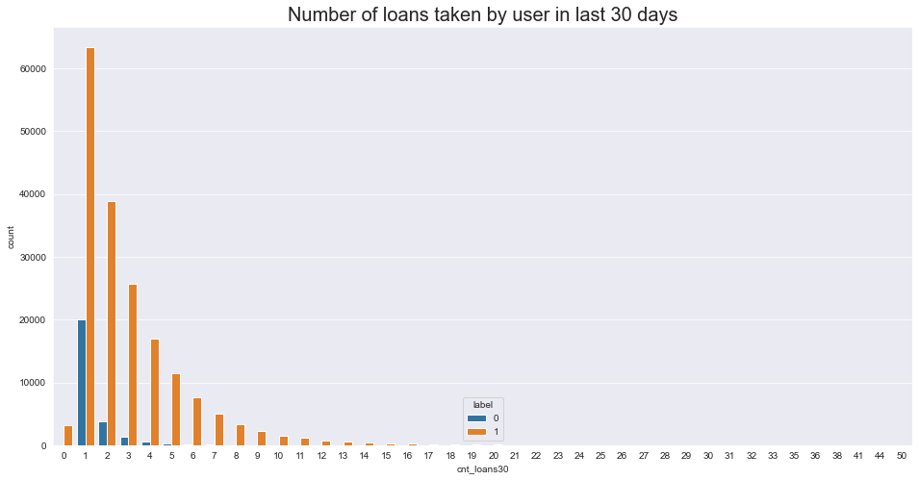
The trends shows, when number of loan taken by user decreases, it's tendency to be a defaulter is also goes down.

Slide 20
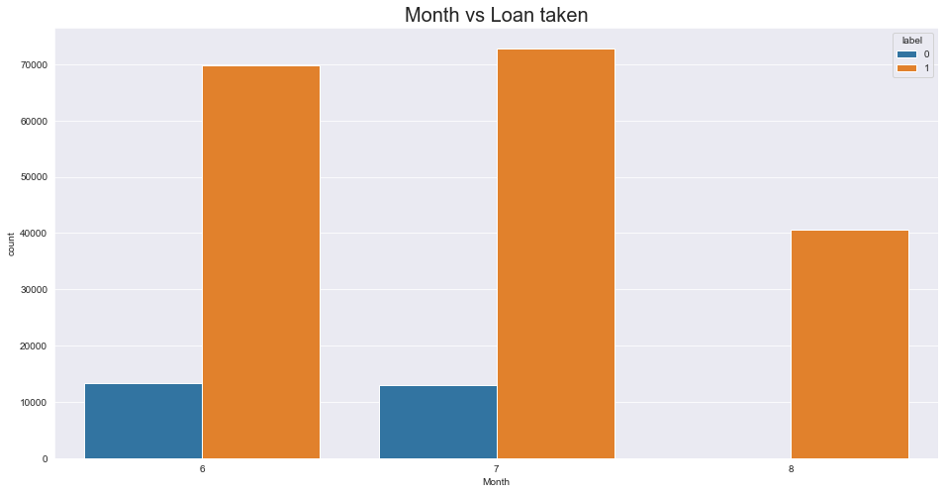
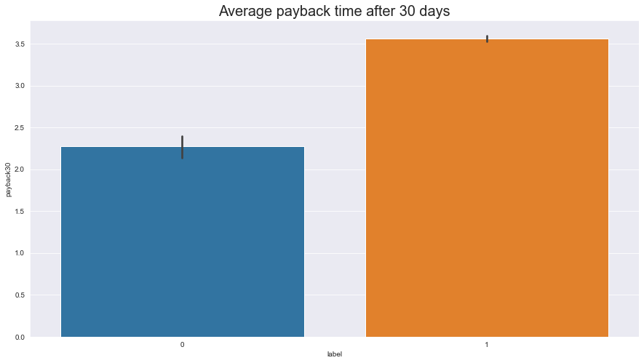
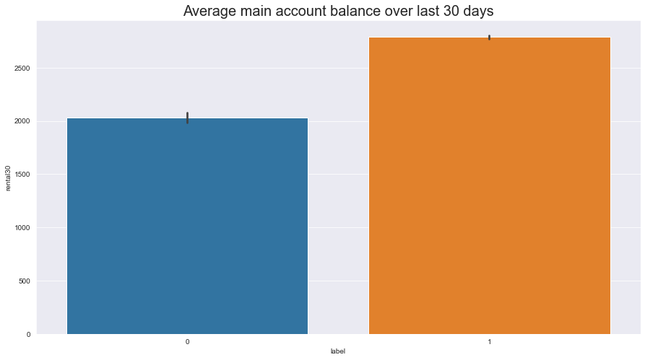

Slide 21
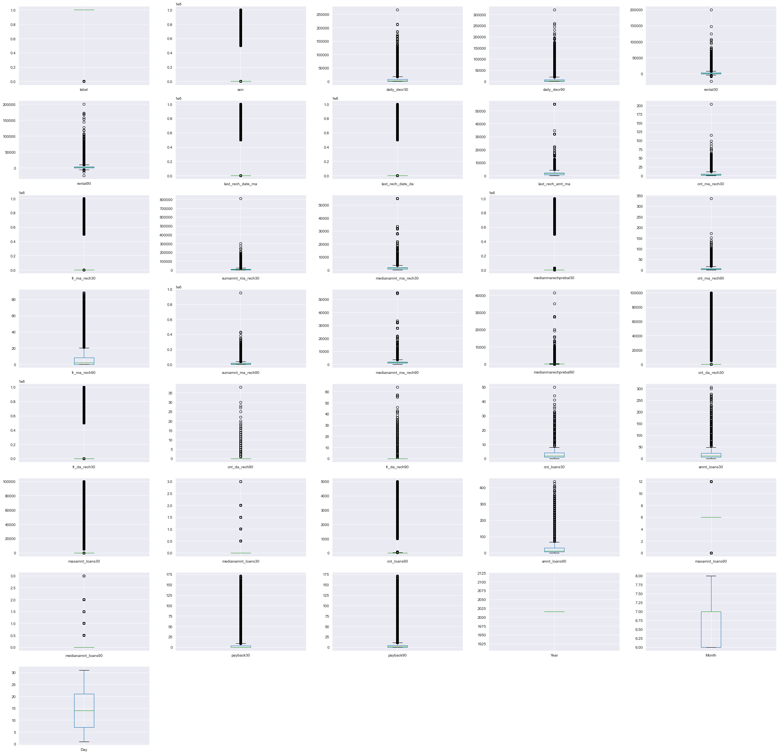
Outlier Detection
Very high number of outliers are present in our dataset.

Slide 22
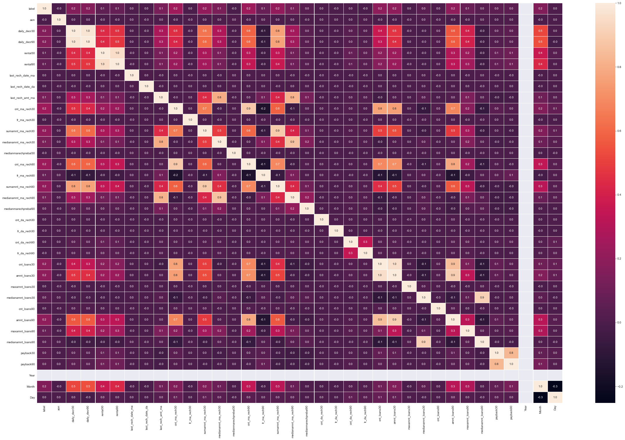
Correlation:

Slide 23
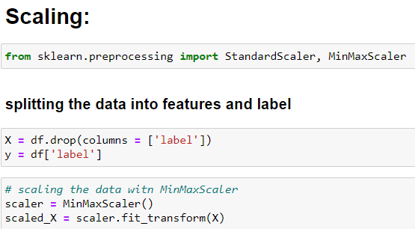
Data scaling
We have done with the standardize the data, but it did not do any changes in the data set because we already had transformed our data set by power_transform method to remove skewness. All right so from here we will go for model building, first we will find the best random state for logistic regression and after finding the best randome state we will split the data into training data & testing data to train the model in different algorithms & to test the trained model.

Slide 24
Observations:
After doing the research on data analysis we found that data was messed up too much, before visualizing we have seen the statistical description of the continuous columns and found that in almost each case standard deviation was greater than the mean of the data the reason for this was because in each case up to 90% data was distributed on either a single point or in a definite range but 10% data was far ahead than them. Box visualization shows us that the amount of the outliers are very much, we can’t afford to loose this much data hence we applied power transformation (yeo-Johnson) method to remove the skewness. It did well in most of the cases but not in all the cases. Because we have transformed the data through power transformation we move ahead in the process of model building. After this we did some preprocessing of the data, we scaled the data, found the best random state for train test & split, than we split the data into train data & test data. After preprocessing we started building the model.

Slide 25
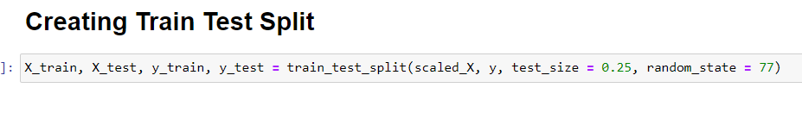
Import Libraries
from sklearn.model_selection import train_test_split
from sklearn.linear_model import LogisticRegression
from sklearn.neighbors import KNeighborsClassifier
from sklearn.tree import DecisionTreeClassifier
from sklearn.ensemble import RandomForestClassifier
from sklearn.svm import SVC
from sklearn.metrics import accuracy_score, classification_report, confusion_matrix, roc_curve, roc_auc_score, plot_roc_curve
from sklearn.model_selection import GridSearchCV,cross_val_score

Slide 26
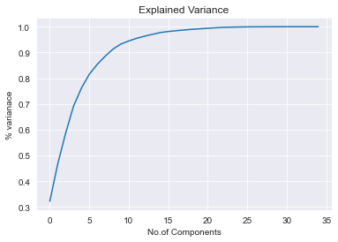
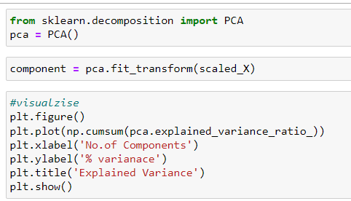
Principle Component Analysis

Slide 27
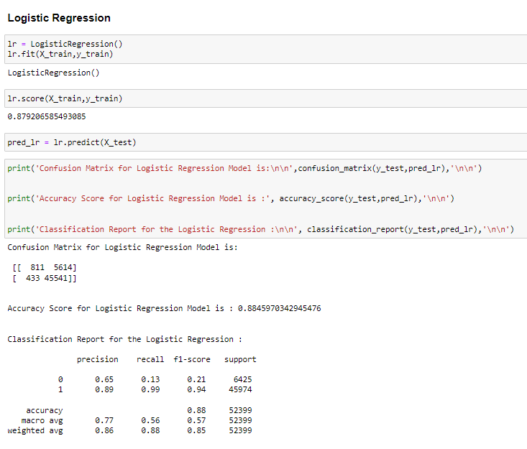
Model Building

Slide 28
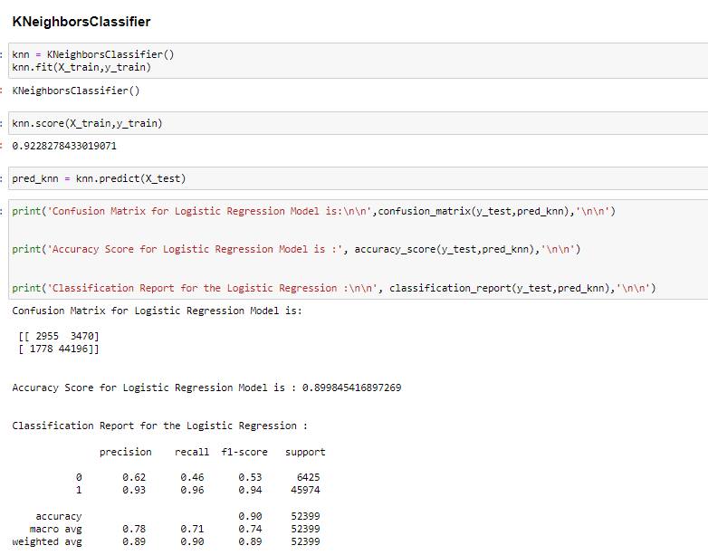

Slide 29
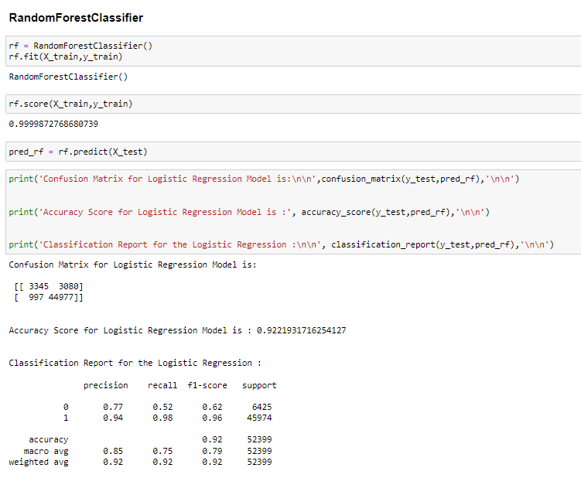

Slide 30
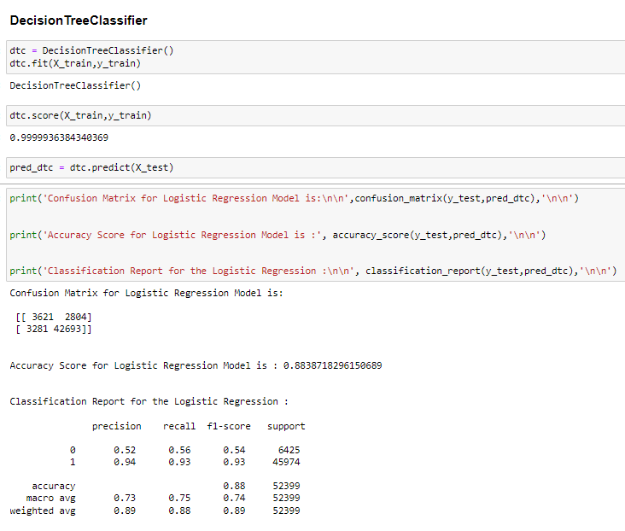

Slide 31
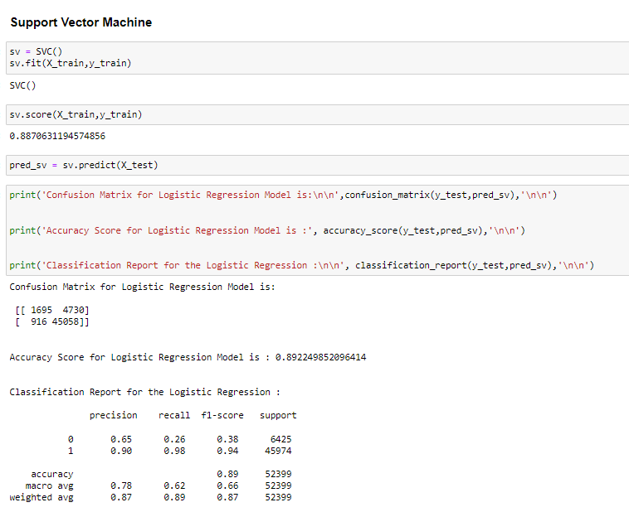

Slide 32
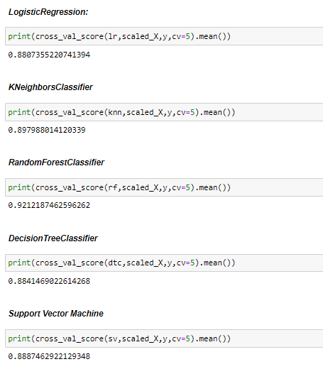
Cross validation
We can seen that Decision Tree model's cross validation accuracy has given greater accuracy than default model accuracy & After that Random Forest Model has very least difference between model's default accuracy & cross validation accuracy. So from here we have concluded that we have 2 best models for Micro credit Defaulter.

Slide 33
Models | Accuracy | Cross Validation Score
Logistic Regression | 88.45% | 88.07%
KNeighbours Classifier | 89.98% | 89.79%
Random Forest Classifier | 92.21% | 92.12%
Decision Tree Classifier | 88.38% | 88.41%
Support Vector Machine | 89.22% | 88.87%

Slide 34
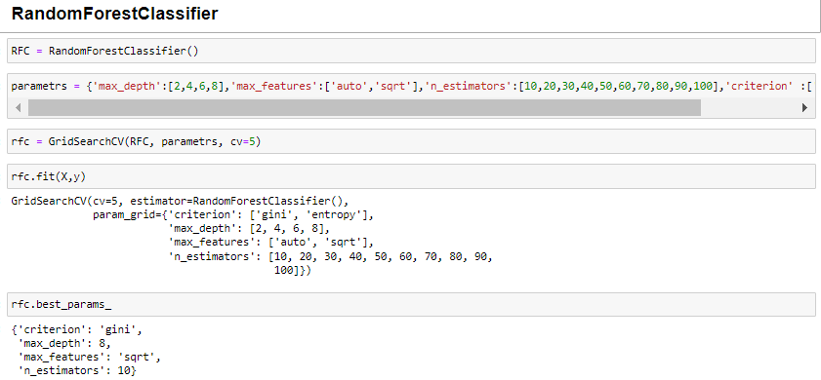
Hyper Parameter Tuning

Slide 35
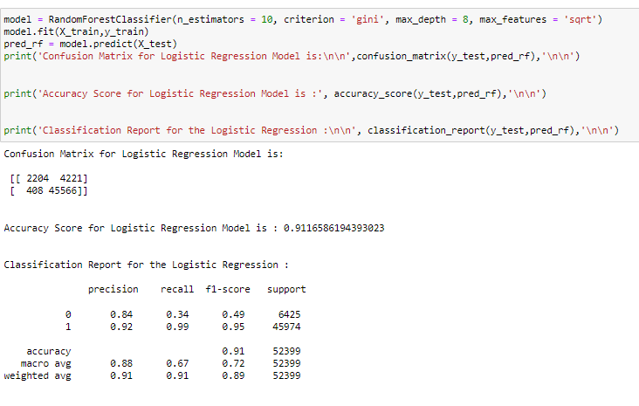

Slide 36
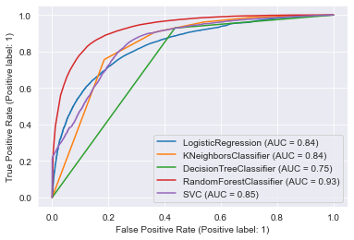
AUC-ROC Curve
From ROC plot we can see that Random Forest Model has the highest area under the curve.

Slide 37
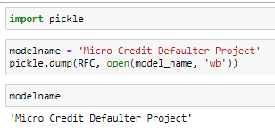
Model Saving

Slide 38
CONCLUSION
From this dataset I get to know that each feature plays a very import role to understand the data. Data format plays a very important role in the visualization and Appling the models and algorithms.
The power of visualization is helpful for the understanding of data into the graphical representation its help me to understand that what data is trying to say, Data cleaning is one of the most important steps to remove missing value or null value fill it by mean median or by mode or by 0.
Various algorithms I used in this dataset and to get out best result and save that model. The best algorithm is Random Forest Classifier.

